Slide 1
DAV INSTITUTIONS ,ODISHA ZONE-1
CLASS-IX
DAV PUBLIC SCHOOL,POKHARIPUT,BHUBANESWAR
MATHS
DERARTMENT OF MATHEMATICS

Slide 2
PREPARED BY PRITI PARIMITA DAS

Slide 3
Learning Objectives
The Students will be able to –
Extend their concept beyond integers and define Rational and Irrational numbers.
Distinguish Rational numbers from natural numbers, whole numbers and integers.
Compute ‘n’ numbers of Rational numbers between any two given rational numbers.
Diagrammatically represent irrational numbers on the number line.
Formulate various ways of rationalization of irrational numbers.
Apply the laws of exponents as per the requirements.
Appraise the use of number system in higher level of study.

Slide 5
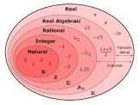
Natural (N)
Whole (W)
Integers (Z)
Rational (Q)
Irrational (s)
Try to define these terms with examples.

Slide 6
RATIONAL NUMBER
A number r is called a rational number, if it can be written in the form $\frac{p}{q},where p and q are integers and q≠0$
For example- -75 can be written in the form $\frac{−75}{1}\left(\frac{p}{q}\right)$
We know that the rational numbers do not have a unique representation in the form $\frac{p}{q}, where p and q are integers and q≠0.$
For example- $\frac{1}{2}=\frac{2}{4}=\frac{10}{20}=\frac{25}{30}=\frac{47}{94}, and so on$.
These are equivalent rational numbers.

Slide 7
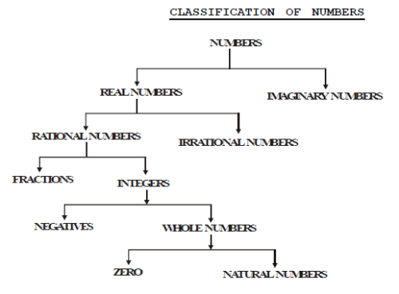
Once we are able to define the types of numbers, let us try to answer these questions:
Is every whole number a natural number?
Is every integer a rational number?
Is every natural number a whole number?
Is every whole number an integer?
Is every rational number a natural number?
Is every rational number a whole number ?
Is every rational number an integer?
Is every whole number a rational number?

Slide 8
Is it difficult to answer? To answer these questions easily, look at the table done below.
Rational number
Integers
n
Whole nos.
n
Natural nos.

Slide 10
How many rational numbers lies between two rational nos? Ans. There are infinitely many rational numbers between any two given rational numbers.
But how??
To find a rational number between two rational numbers(a and b),we can add a and b and divide the sum by 2,that is $\frac{a+b}{2} lies between a and b.$
For example rational nos. between 1 and 2 are $\frac{3}{2},\frac{5}{4},\frac{11}{8},\frac{13}{8},\frac{7}{4},…….$

Slide 11
There is another way too to find rational nos. between two rational numbers.
Suppose the question is to find five rational nos. between 1 and 2.
As we want five numbers ,we write 1 and 2 as rational nos. with denominator 5+1,i.e. $1=\frac{6}{6} and 2=\frac{12}{6}.$
Then the nos. are $\frac{7}{6},\frac{8}{6},\frac{9}{6},\frac{10}{6},\frac{11}{6}$
Or else try to make the denominators equivalent.
Like,$1=\frac{10}{10}and2=\frac{20}{10}, then the nos. are\frac{11}{20},\frac{12}{20},…..\frac{19}{20}$

Slide 12
WORKSHEET:1
Is 0 a rational number ? justify.
Find six rational numbers between 3 and 4.
Find five rational numbers between $\frac{3}{5} and\frac{4}{5}$

Slide 13
IRRATIONAL NUMBERS
A number s is called irrational, if it cannot be written in the form $\frac{p}{q},where p and q are integers and q≠0$
As we know there are infinitely many rational numbers ,in turn that are also infinitely many irrational numbers too.
Now the collection of rational and irrational numbers are known as REAL NUMBERS(R)
Therefore, a real number is either rational or irrational. So, every real number is represented by a unique point on the number line.
Also, every point on the number line represents a unique real number known as real number line.

Slide 14
DIFFERENCE BETWEEN RATIONAL AND IRRATIONAL NUMBERS

Slide 16
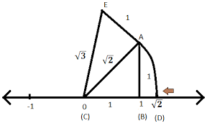
Representing irrational numbers on the number line.
Can use Pythagoras theorem to represent irrationals on the number line.
Onto the number line take the vertex O coincides with zero.
Take OA as 1 unit in length and OB as 1 unit, then by Pythagoras theorem OB= $\sqrt{1^{2}+1^{2} }$=$√2$.
Using compass with centre O and radius OB, draw an arc intersecting the number line at the point P. Then P corresponds to $√2$ on the number line.
Similarly, $\sqrt{3}$ can be represented on the no.line by taking the base as $\sqrt{2}$units and perpendicular 1 unit.

Slide 17
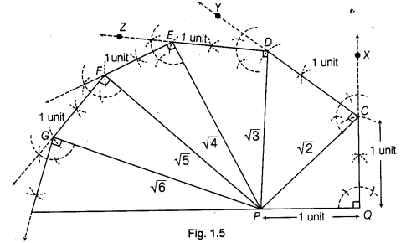

Slide 18
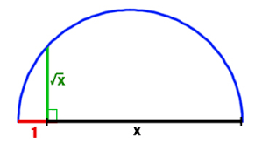
Another way to represent irrationals on the number line
Show how $\sqrt{5}$ can be represented on the number line.
Draw a line segment AB=5 cm.
From B, mark BC=1 cm.
Now, draw the perpendicular bisector of AC and mark the bisector point as O.
Draw a semicircle taking OA as radius.
Draw a line perpendicular to AC through B and intersecting the semi circle at D. Then $BD=√5$ units.
Now draw a no. line and cut an arc length of BD from 0, which represents $√5$ on the no. line.

Slide 19
The Square Root Spiral ( or “Wheel of Theodorus” or
“Einstein Spiral” or “Wurzel Spirale” ) is a very interesting geometrical structure, in which the square roots of all natural numbers have a clear defined spatial orientation to each other

Slide 20
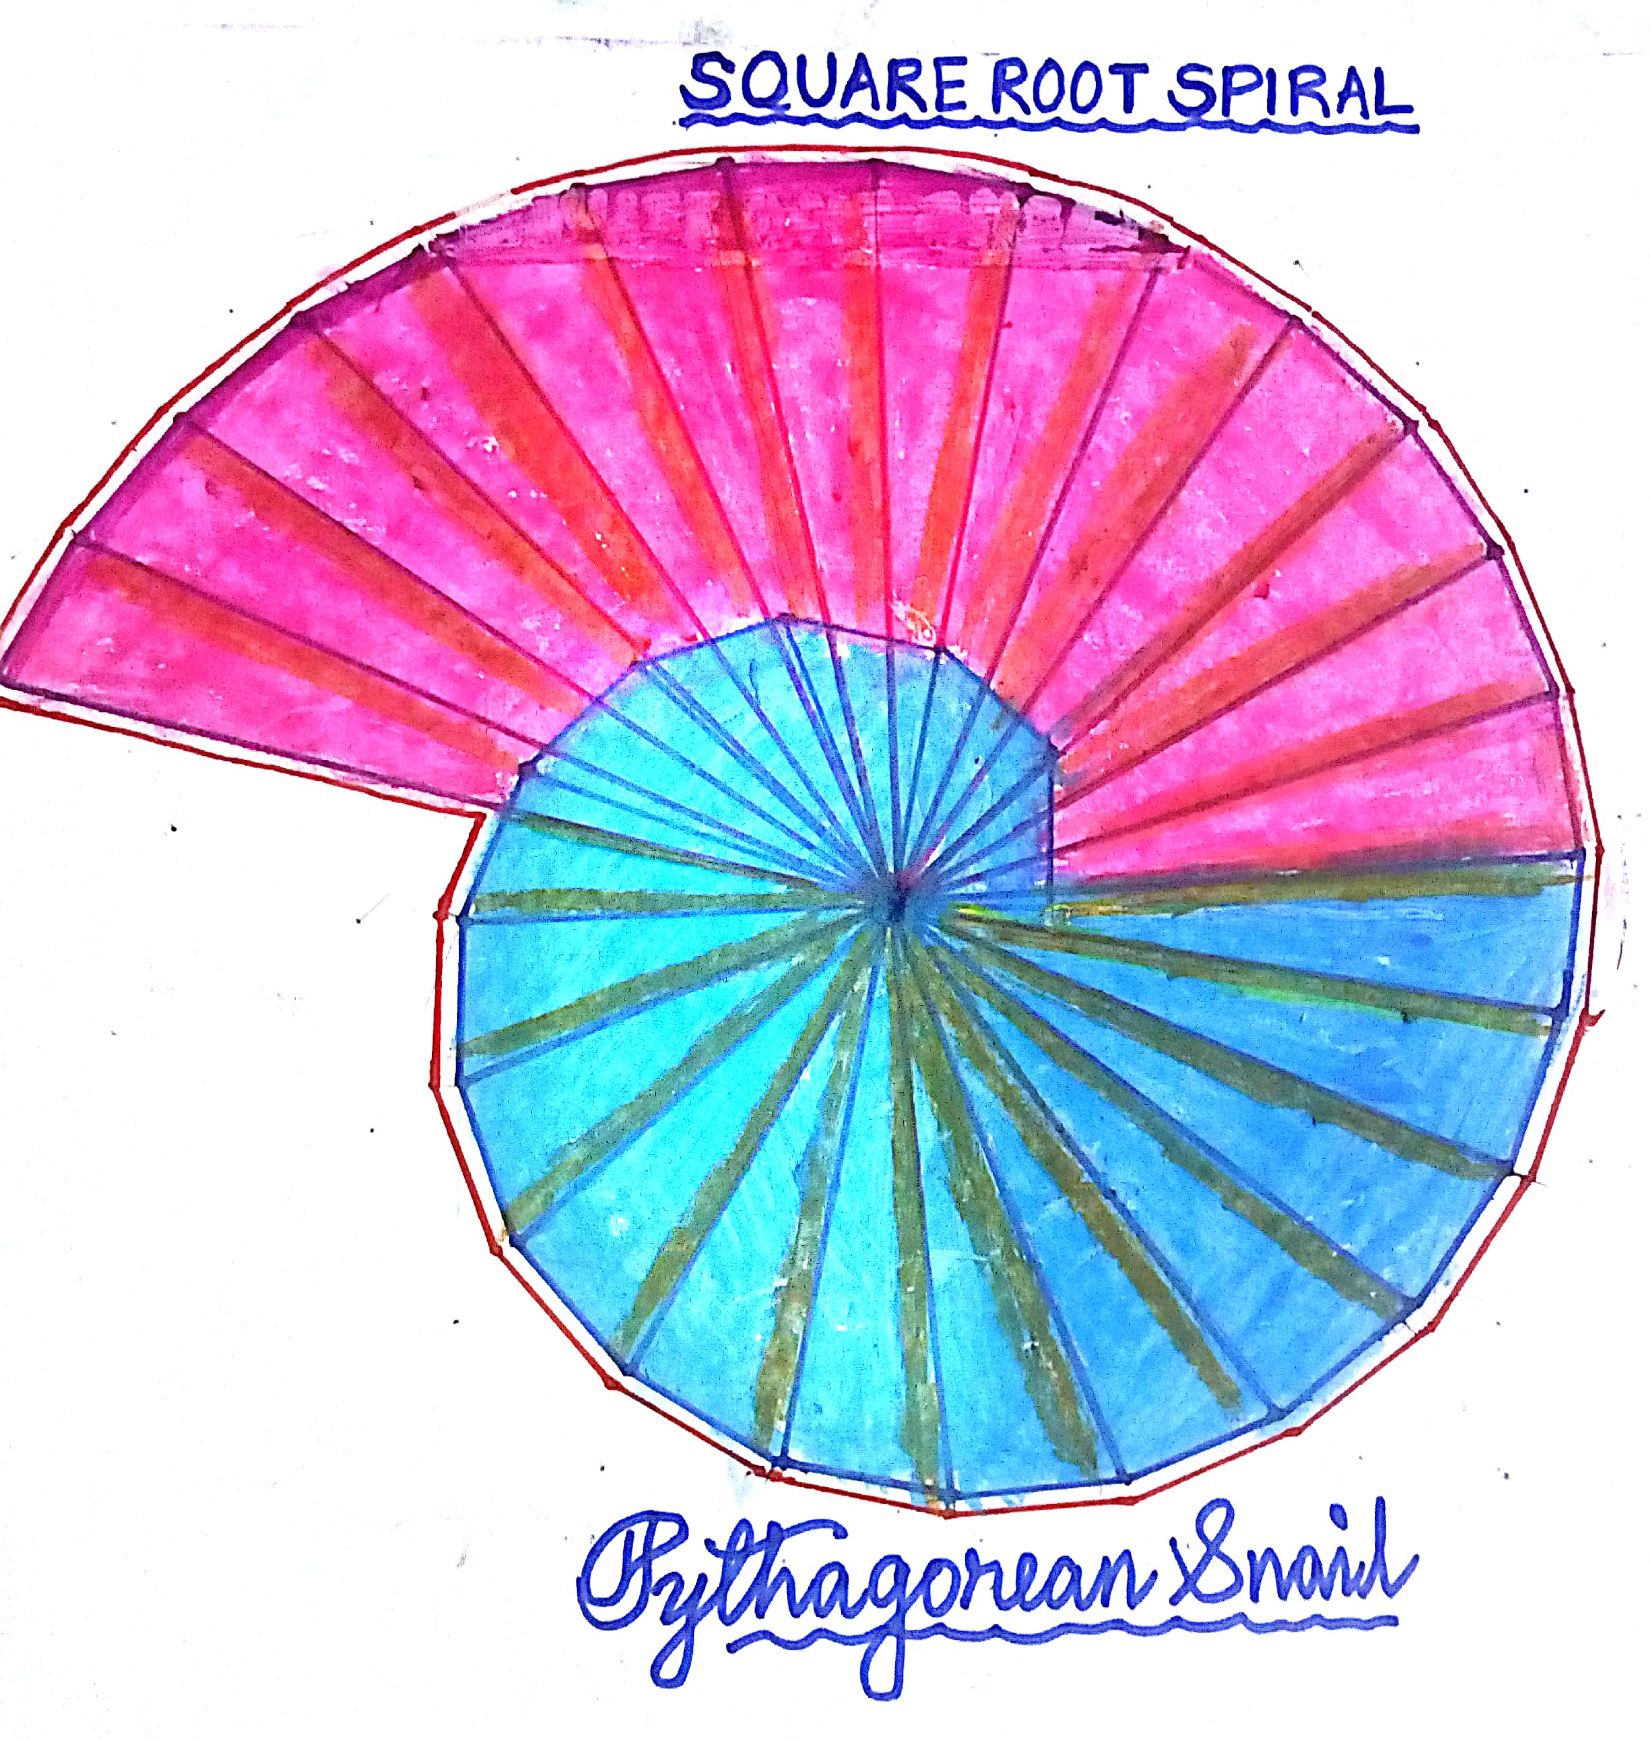
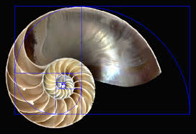
ART INTEGRATION
https://youtu.be/M6R68nqa38A

Slide 21
ART INTEGRATION

Slide 22
WORKSHEET-2
Locate square root of 2,3,5,6,7 on the number line.
Construct the square root spiral till square root of 10.

Slide 23
Real numbers and their decimal expansions
Decimal expansion of rational number is either terminating or non-terminating repeating expansion and vice versa.
Ex-0.54,1.444444……..,4.565656….
Decimal expansion of irrational number is non-terminating non-repeating expansion and vice versa
Ex-1.02002000200002…….,34.778887778887777…..
NOTE- Let $x=\frac{p}{q}$ be a rational number, such that the prime factorisation of q is of the form $2^{m}5^{n}$, where $m and n are non negative integers.$
Then $x$ has a decimal expansion which terminates. And if prime factorisation of q is not of the form $2^{m}5^{n}$, then $x$ has a decimal expansion which is non- terminating repeating.

Slide 26
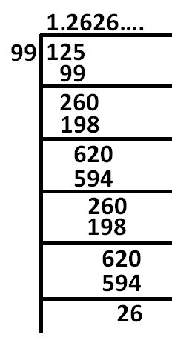

Slide 27
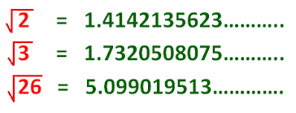

Slide 29
Find four irrational numbers between the rational numbers $\frac{5}{7} and\frac{9}{11}$
$\frac{5}{7}=0.7142857142 and\frac{9}{11}=0.818181$
As we know the decimal expansion of irrational numbers is non terminating non repeating ,the four irrational numbers between the given numbers are
0.727227222722227…….
0.747447444744447……
0.808008000800008……
0.797997999799997…..

Slide 30
Solve these questions:
Show that 1.272727….can be expressed in the form of $\frac{p}{q} ,where p and q are integers and q≠0.$
Ans- Let $x=1.272727….$
Since two digits are repeating ,we multiply $x$ by 100 to get
$$100x=127.272727….$$
Therefore, $100x−x=127.272727….−1.272727…..=126$
$$99x=126$$
Therefore, $x=\frac{126}{99}=\frac{14}{11}$

Slide 31
Show that 0.2353535…can be expressed in the form $\frac{p}{q}$where $p and q are integers and q≠0.$
Let $x=0.23535….$
Look here, 2 does not repeat, but the block 35 repeats.
So, we can multiply $x$ by 10 to get $10x=2.353535…..−−−−\left(1\right)$
And now can multiply $x by 1000 to get 1000x=235.3535…−$(2)
Subtracting (1) from (2) we get,
$$990x=233$$
Therefore, $x=\frac{233}{990}$

Slide 32
WORKSHEET-3 Express the following in the form $\frac{p}{q}, where p and q are integers and q≠0$
0.6
0.477777…..
1.234444…..
0.001001001…….
0.99999…..

Slide 33
Representing Real Numbers on the Number Line

Slide 35
Operations on Real Numbers
The sum of a rational and an irrational number is irrational.
The difference of a rational and an irrational number is irrational.
The quotient of a non-zero rational number with an irrational number is irrational.
The product of a non-zero rational number with an irrational number is irrational.
The sum of two irrational numbers may be rational or irrational.
The difference of two irrational numbers may be rational or irrational.
The product of two irrational numbers may be rational or irrational.
The quotient of two irrational numbers may be rational or irrational.

Slide 36
The statement we have seen in the last slide, now we will justify with examples.
$2+\sqrt{5 }$ $\left(rational+irrational=irrational\right)$
$3−√2\left(rational−irrational=irrational\right)$
$\frac{4\sqrt{5}}{2}=2√5$ $\left(irrational÷rational=irrational\right)$
$4×3\sqrt{3}=12√3\left(rational×irrational=irrational\right)$
$2\sqrt{3}+\sqrt{3}=3√3\left(irrational+irrational=irrational\right)$
$\left(2−\sqrt{3}\right)+\sqrt{3}=2$ ($irrational+irrational=rational$)

Slide 37
$2\sqrt{3}−\sqrt{3}=√3\left(irrational−irrational=irrational\right)$
$\left(2+\sqrt{3}\right)−\sqrt{3}=2$ ($irational−irrational=rational\text{)}$
$\sqrt{3}×\sqrt{3}=3$($irational×irrational=rational\text{)}$
$\sqrt{2}×\sqrt{3}=\sqrt{6}$ $(irational×irrational=irrational\text{)}$
$\frac{6\sqrt{5}}{3\sqrt{5}}=2$ $(irational÷irrational=rational\text{)}$
$\frac{8\sqrt{15}}{2\sqrt{5}}=4√3$ $(irational÷irrational=irrational\text{)}$
The same way give some more examples for each.

Slide 38
Rationalising the denominator
The rationalising factor of $\frac{1}{\sqrt{2}}$ is $√2$.($\frac{1}{\sqrt{2}}×\frac{\sqrt{2}}{\sqrt{2}}=\frac{\sqrt{2}}{2})$
The rationalising factor of $\frac{1}{2+\sqrt{2}}$ is $2−\sqrt{2}.(\frac{1}{2+\sqrt{2}}×\frac{2−√2}{2−√2}$ = $\frac{2−\sqrt{2}}{2})$
The rationalising factor of $\frac{1}{7−3\sqrt{5}}$ is $7+3√5.(\frac{1}{7−3\sqrt{5}}×\frac{7+3√5}{7+3√5}$ = $\frac{7+3\sqrt{5}}{4})$
The rationalising factor of $\frac{1}{3\sqrt{7}} is \sqrt{7}.\left(\frac{1}{3\sqrt{7}}×\frac{\sqrt{7}}{\sqrt{7}}=\frac{\sqrt{7}}{21}\right)$
The rationalising factor of $\frac{2+√3}{7−3\sqrt{5}}$ is $7+3\sqrt{5}$
$\frac{2+√3}{7−3\sqrt{5}}$ $×\frac{7+3√5}{7+3√5}$=$\frac{(2+\sqrt{3})(7+3\sqrt{5})}{(7−3\sqrt{5})(7+3\sqrt{5})}$=$\frac{2\left(7+3\sqrt{5}\right)+√3(7+3\sqrt{5})}{7^{2}−{(3\sqrt{5})}^{2}}$=$\frac{14+6\sqrt{5}+7\sqrt{3}+3√15}{4}$

Slide 39
WORKSHEET-4 Rationalise the denominators of the following:
$\frac{1}{\sqrt{7}}$
$\frac{3}{5\sqrt{6}}$
$\frac{5}{2+5\sqrt{7}}$
$\frac{1}{7−√5}$
$\frac{3+\sqrt{7}}{√5−\sqrt{3}}$

Slide 40
Laws of exponents for real numbers
We define $\sqrt[n]{a}=a^{\frac{1}{n}}$
$a,m and n are the natural nos. where a is the base and m and n are the exponents.$
$a^{m}×a^{n}$= $a^{m+n}$
$\frac{a^{m}}{a^{n}}$= $a^{m−n}$
${{(a}^{m})}^{n}$=$a^{mn}$
$a^{m}b^{m}$=${(ab)}^{m}$
$a^{0}$=1
$\frac{1}{a^{n}}$= $a^{−n}$
$${64}^{\frac{1}{2}}$$
$${32}^{\frac{1}{5}}$$
$${125}^{\frac{1}{3}}$$
$$2^{\frac{2}{3}}2^{\frac{1}{5}}$$
$${13}^{\frac{1}{5}}{17}^{\frac{1}{5}}$$
WORKSHEET-5
EVALUATE:

Slide 41
CONCEPT MAP

Slide 42
WORSHEET(BASIC)
TIME-45 Min MAX.MARKS:20
1.Choose the correct option: (2 X1=2)
Every rational number is
a. natural number b. an integer c. a real number d. a whole number
Between two rational numbers
a. There is no rational number c. There are infinitely many rational number
b. There is exactly one rational number. d. there only rational numbers and no irrational numbers.
2. Fill in the blanks: (2 X1=2)
The decimal expansion of $\sqrt{7}$ is __________
The only even prime number is ___
3. Answer the following: (2 X1=2)
Find an irrational number between $\frac{1}{7} and \frac{2}{7}$
Find the rationalising factor for $\frac{1}{3+√5}$

Slide 43
4. Short Answer Type Question –I (2 X 2=4)
Express $0.1\overline{25}$ in the form of $\frac{p}{q}$ where $p and q are integers and q≠0.$
Locate $\sqrt{3}$on the number line.
5. Short Answer Type Question –II (2 X 3=6)
If $a=2+\sqrt{3} , find the value of a−\frac{1}{a}$
Simplify $\frac{\sqrt{25}}{\sqrt[3]{64}}+({\frac{256}{625})}^{\frac{−1}{4}}+\frac{1}{({\frac{64}{125})}^{\frac{2}{3}}}$
6. Long answer type question: (1 X 4= 4)
Evaluate $\frac{1}{\sqrt{2}+1}+\frac{1}{\sqrt{3}+√2}+\frac{1}{\sqrt{4}+√3}+…+\frac{1}{\sqrt{9}+√8}$
-----------------------------------------------------------------------------------------------

Slide 44
WORSHEET(STANDARD)
TIME-45 Min MAX.MARKS:20
1. Choose the correct option: (2 X1=2)
A rational number between $\sqrt{2}and √3$ is
a. $\frac{\sqrt{3}+\sqrt{2}}{2}$ b. 1.52 c. 1.92 d. $\frac{\sqrt{3}\sqrt{2}}{2}$
Decimal expansion of a rational number cannot be
a. Terminating b. non- terminating c. non- terminating repeating d. non- terminating non- repeating
2. Fill in the blanks: (2 X1=2)
The product of $\sqrt[3]{2}$ $\sqrt[4]{2} \sqrt[12]{32}$ is ____________
The value of $\frac{\sqrt{112}−√80}{\sqrt{20}−√28}$ is ___________
3. Answer the following: (2 X1=2)
Is product of two irrational numbers always irrational? Justify?
Which is greater $\sqrt[3]{3} or \sqrt[4]{4} ?justify?$

Slide 45
4. Short Answer Type Question –I (2X 2=4)
Simplify $\sqrt[4]{81}−8\sqrt[3]{216}$ $+15\sqrt[5]{32}+√225$
Simplify ${(256)}^{{−(4}^{\frac{−3}{2}})}$
5. Short Answer Type Question –II (2X 3=6)
Locate $3\sqrt{5}$on the number line.
If $a=3+2\sqrt{2},then find the value of a^{3}+\frac{1}{a^{3}}$
6. Long answer type question: (1 X 4= 4)
Find the value of $a and b : \frac{7+√5}{7−√5}+\frac{7−√5}{7+√5}=a+\frac{7}{11}\sqrt{5}b$
------------------------------------------------------------------------

Slide 46
WORSHEET(ADVANCE)
TIME-45 Min MAX.MARKS:20
1. Choose the correct option: (2 X1=2)
The value of 2.999…. in the form of $\frac{p}{q} where p and q are integers and q≠0, is$
a. $\frac{2999}{1000}$ b. $\frac{19}{10}$ c. 3 d. $\frac{26}{9}$
The value of $\sqrt[5]{∜3^{2}}$ is equal to
a. $3^{10}$ b. $\frac{1}{3^{−10}}$ c. $3^{\frac{1}{10}}$ d. $3^{−10}$
2. Fill in the blanks: (2 X1=2)
The value of $\frac{4\sqrt{3}+5\sqrt{2}}{\sqrt{48}+√18}is __________$
The value of $2\sqrt[3]{40}+3\sqrt[3]{625}−4\sqrt[3]{32}0$ is _________
3. Answer the following: (2 X1=2)
If $a=b^{2x},b=c^{2y},c=a^{2z}, find the value of xyz$
Show that: $\frac{x^{a(b−c)}}{x^{b(a−c)}}÷({\frac{x^{b}}{x^{a}})}^{c}$=1

Slide 47
4. Short Answer Type Question –I (2X 2=4)
If $x=9−4\sqrt{5}, find the value of \sqrt{x}−\frac{1}{√x}$
If $2^{x}=3^{y}=6^{−z}, prove that \frac{1}{x}+\frac{1}{y}+\frac{1}{z}=0$
5. Short Answer Type Question –II (2X 3=6)
Find the value of $\frac{2(\sqrt{2}+\sqrt{6})}{3\sqrt{2+√3}}$
Find the value of $\frac{\sqrt{\sqrt{5}+2 }}{\sqrt{\sqrt{5}+1}}$ + $\frac{\sqrt{\sqrt{5}−2 }}{\sqrt{\sqrt{5}+1}}$
6. Long answer type question: (1 X 4= 4)
If $x=\frac{1}{2−√3}, find the value of x^{3}−2x^{2}−7x+4$
---------------------------------------------------------------------

